Slide 1
APS106 – Final Exam
Thursday April 14th, 2022

Slide 2
Long Answer Questions
Disclaimer: There may be other ways to solve these problems! There is never one single solution.

Slide 3
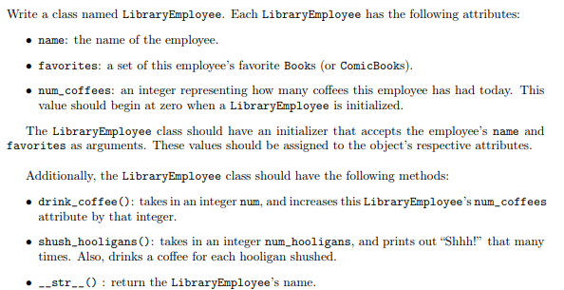
Question 1 – Classes (not from a midterm)
Copyright: Stanford
Notes:
This is a good one; use the wording from the Classes function on slide 6

Slide 4
OOP Recap
Class
A class can be thought of as a template for the objects that are instances of it.
Attributes
Data
Methods
Functions

Slide 5

OOP Recap
Turtle
Instances (objects) of the Turtle class.
name
x location
y location
name: Susmit
x location: 134
y location: 45
name: Lucy
x location: 24
y location: 35
move up
move down
move left
move right
go to
name: Brian
x location: 92
y location: 62

Slide 6
OOP Recap
class Name:
def __init__(self, param1, param2, …):
self.param1 = param1
self.param2 = param2
…
body
def method1(self, parameters):
body
def method2(self, parameters):
body
def method3(self, parameters):
body
General form of a Class:
Class Name
CamelCase
CourseGrades
BankAccount
FlightStatus
XRayImage
Constructor
Methods

Slide 7
OOP Recap
self
Reference to the instance of the class.
class Turtle:
def __init__(self, x, y):
self.x = x
self.y = y
def up(self):
self.y += 1
def goto(self, x, y):
self.x = x
self.y = y
def get_position(self):
return self.x, self.y

Slide 8
OOP Recap
Because at the time of designing the class we don’t know what these instance names will be, we just chose one.
self
class Turtle:
def __init__(self, x, y):
self.x = x
self.y = y
def up(self):
self.y += 1
def goto(self, x, y):
self.x = x
self.y = y
def get_position(self):
return self.x, self.y

Slide 9
OOP Recap
def my_func():
print(“Hello”)
my_func
Accessing attributes (Data) and methods (Functions) is different.
This function has not been called.
ben = Turtle(0, 0)
ben.x
ben.up()
Attribute.
A Method is a function, and we call functions using parentheses.

Slide 10
OOP Recap
seb = Turtle(0, 0)
class Turtle:
def __init__(self, x, y):
self.x = x
self.y = y
def up(self):
self.y += 1
def goto(self, x, y):
self.x = x
self.y = y
def get_position(self):
return self.x, self.y
These parameters are passed to the constructor (the __init__ method).

Slide 11
See Jupyter Notebook for the solution!

Slide 12
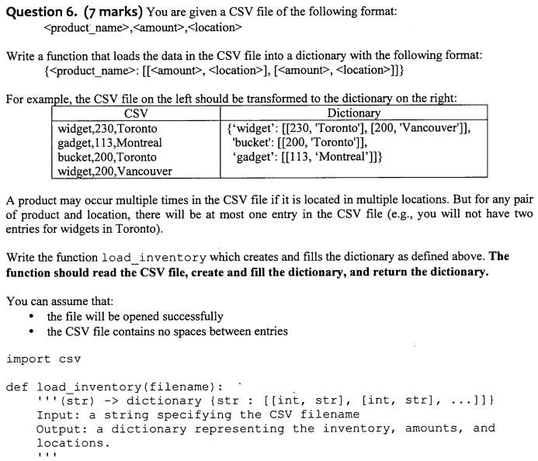
Question 2 – String manipulation & CSVs (modified from exam!)
CSV | Dictionary
widget,230,Toronto-Ontario gadget,113,Montreal-Quebec bucket,200,Toronto-Ontario widget,200,Vancouver-BC | {‘widget’: [[230, [‘Toronto’, ‘Ontario’]], [200, [‘Vancouver’, ‘BC’]]], ‘bucket’:[[200, [‘Toronto’, ‘Ontario’]]], ‘gadget’: [[113, [‘Montreal’, ‘Quebec’]]
Notes:
This one is better; split (Toronto-Ontario) and incorporate into this

Slide 13

Reading CSV Files
The CSV module is a powerful solution developed for working with CSV files.
Reading of CSV files is done using the CSV reader. You can construct a reader object using csv.reader() which takes the file object as input.
The reader object can be used to iterate through the contents of the CSV file, similarly to how a file object was used to iterate through the contents in a text file.

Slide 14

Example: Reading a CSV File (open)
Read each row of a CSV file using open
import csv
csvfile = open("grades.csv", "r")
grades_reader = csv.reader(csvfile)
row_num = 1
for row in grades_reader:
print('Row #', row_num, ':', row)
row_num += 1
csvfile.close()
Row # 1 : ['Name', 'Test1', 'Test2', 'Final']
Row # 2 : [‘Kendrick', '100', '50', '29']
Row # 3 : [‘Dre', '76', '32', '33']
Row # 4 : [‘Snoop', '25', '75', '95']

Slide 15
Example: Reading a CSV File (with)
Read each row of a CSV file using with
import csv
with open('grades.csv', 'r') as csvfile:
grades_reader = csv.reader(csvfile)
row_num = 1
for row in grades_reader:
print('Row #', row_num, ':', row)
row_num += 1
Row # 1 : ['Name', 'Test1', 'Test2', 'Final']
Row # 2 : [‘Kendrick', '100', '50', '29']
Row # 3 : [‘Dre', '76', '32', '33']
Row # 4 : [‘Snoop', '25', '75', '95']

Slide 16
Writing CSV Files
To write to the file we would first need to create a CSV writer object, csv.writer(), which similar to how we made a, CSV reader object.
Once the CSV writer object is created, we can use the writerow() method to populate it with data.
The writerow()method can only write a single row to the file at a time.

Slide 17
Example: CSV Files
In the previous grade example there were a few marking errors on the final exam and both John and Mark should have received a higher grade. Update the grades using the CSV writerow()method.
import csv
grades = [['Name', 'Test1', 'Test2', 'Final'],
[‘Kendrick', '100', '50', '69'],
[‘Dre', '76', '32', '53'],
[‘Snoop', '25', '75', '95']]
with open('grades_new.csv', 'w') as csvfile:
grades_writer = csv.writer(csvfile)
for row in grades:
grades_writer.writerow(row)

Slide 18
See Jupyter Notebook for the solution!

Slide 19
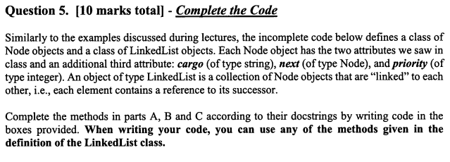
Question 3 - LinkedLists

Slide 20
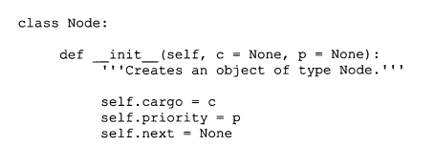
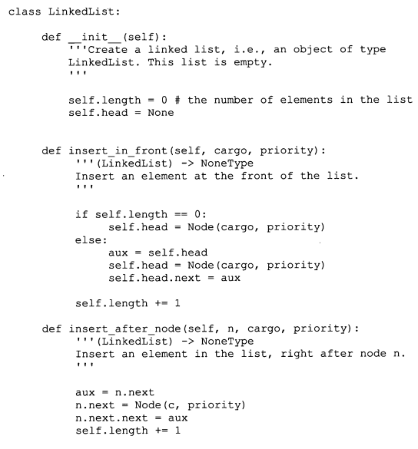
Question 3 - LinkedLists

Slide 21
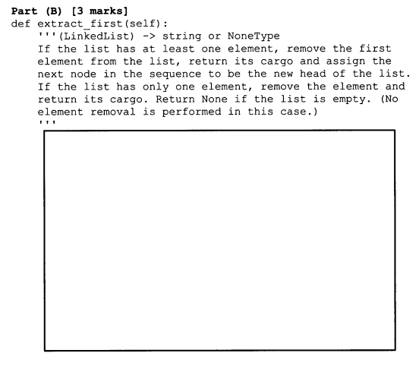
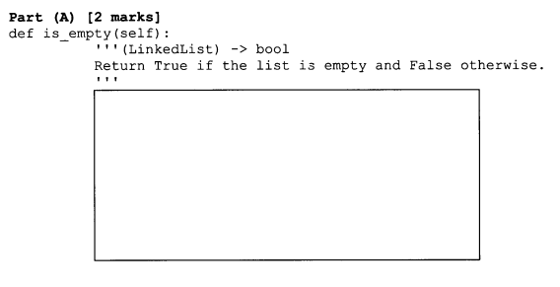
Parts of the question

Slide 22
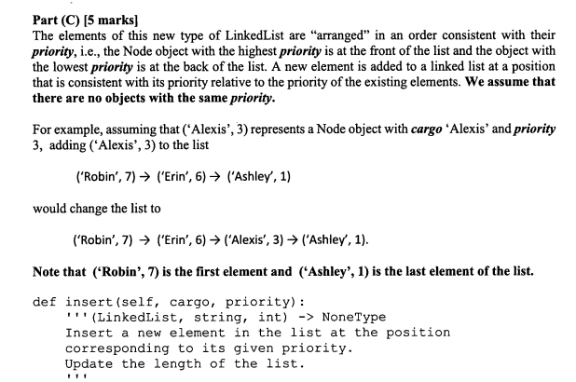
Parts of the question

Slide 23
class LinkedList: """A class that implements a linked list.""" def __init__(self): """ (self) -> NoneType Create an empty linked list. """ self.length = 0 self.head = None def __str__(self): ... def add_to_head(self, cargo): ... def add_to_tail(self, cargo): ... def get_at_index(self, index): ... def delete_by_cargo(self, cargo): ...
>>> linked_list = LinkedList()
>>> linked_list.__str__() 'empty list'
self.head
None

Slide 24
class LinkedList: """A class that implements a linked list.""" def __init__(self): """ (self) -> NoneType Create an empty linked list. """ self.length = 0 self.head = None def __str__(self): ... def add_to_head(self, cargo): ... def add_to_tail(self, cargo): ... def get_at_index(self, index): ... def delete_by_cargo(self, cargo): ...
add_to_head method.

Slide 25
class LinkedList: """A class that implements a linked list.""" def __init__(self): """ (self) -> NoneType Create an empty linked list. """ self.length = 0 self.head = None def __str__(self): ... def add_to_head(self, cargo): """ (self, object) -> NoneType Add cargo to the front of the list. """ node = Node(cargo) node.next = self.head self.head = node self.length += 1 def add_to_tail(self, cargo): ... def get_at_index(self, index): ... def delete_by_cargo(self, cargo): ...
>>> linked_list = LinkedList()
>>> linked_list.__str__() 'empty list'
self.head
None

Slide 26
class LinkedList: """A class that implements a linked list.""" def __init__(self): """ (self) -> NoneType Create an empty linked list. """ self.length = 0 self.head = None def __str__(self): ... def add_to_head(self, cargo): """ (self, object) -> NoneType Add cargo to the front of the list. """ node = Node(cargo) node.next = self.head self.head = node self.length += 1 def add_to_tail(self, cargo): ... def get_at_index(self, index): ... def delete_by_cargo(self, cargo): ...
>>> linked_list = LinkedList()
>>> linked_list.add_to_head(2)
>>> linked_list.__str__() '(2) --> None'
Add Node
node
self.head
Create Node
None
2
None
.cargo
.next

Slide 27
class LinkedList: """A class that implements a linked list.""" def __init__(self): """ (self) -> NoneType Create an empty linked list. """ self.length = 0 self.head = None def __str__(self): ... def add_to_head(self, cargo): """ (self, object) -> NoneType Add cargo to the front of the list. """ node = Node(cargo) node.next = self.head self.head = node self.length += 1 def add_to_tail(self, cargo): ... def get_at_index(self, index): ... def delete_by_cargo(self, cargo): ...
>>> linked_list = LinkedList()
>>> linked_list.add_to_head(2)
>>> linked_list.__str__() '(2) --> None'
node
self.head
Point to head
2
None
.cargo
.next

Slide 28
class LinkedList: """A class that implements a linked list.""" def __init__(self): """ (self) -> NoneType Create an empty linked list. """ self.length = 0 self.head = None def __str__(self): ... def add_to_head(self, cargo): """ (self, object) -> NoneType Add cargo to the front of the list. """ node = Node(cargo) node.next = self.head self.head = node self.length += 1 def add_to_tail(self, cargo): ... def get_at_index(self, index): ... def delete_by_cargo(self, cargo): ...
>>> linked_list = LinkedList()
>>> linked_list.add_to_head(2)
>>> linked_list.__str__() '(2) --> None'
self.head
Assign new Node to head
2
None
.cargo
.next

Slide 29
class LinkedList: """A class that implements a linked list.""" def __init__(self): """ (self) -> NoneType Create an empty linked list. """ self.length = 0 self.head = None def __str__(self): ... def add_to_head(self, cargo): """ (self, object) -> NoneType Add cargo to the front of the list. """ node = Node(cargo) node.next = self.head self.head = node self.length += 1 def add_to_tail(self, cargo): ... def get_at_index(self, index): ... def delete_by_cargo(self, cargo): ...
>>> linked_list = LinkedList()
>>> linked_list.add_to_head(2)
>>> linked_list.__str__() '(2) --> None'
self.head
Increase length
2
None
.cargo
.next

Slide 30
class LinkedList: """A class that implements a linked list.""" def __init__(self): """ (self) -> NoneType Create an empty linked list. """ self.length = 0 self.head = None def __str__(self): ... def add_to_head(self, cargo): """ (self, object) -> NoneType Add cargo to the front of the list. """ node = Node(cargo) node.next = self.head self.head = node self.length += 1 def add_to_tail(self, cargo): ... def get_at_index(self, index): ... def delete_by_cargo(self, cargo): ...
>>> linked_list = LinkedList()
>>> linked_list.add_to_head(2)
>>> linked_list.add_to_head(4)
>>> linked_list.__str__() '(4) --> (2) --> None'
Add Node
node
self.head
Create Node
None
4
2
None
.cargo
.next
.cargo
.next

Slide 31
class LinkedList: """A class that implements a linked list.""" def __init__(self): """ (self) -> NoneType Create an empty linked list. """ self.length = 0 self.head = None def __str__(self): ... def add_to_head(self, cargo): """ (self, object) -> NoneType Add cargo to the front of the list. """ node = Node(cargo) node.next = self.head self.head = node self.length += 1 def add_to_tail(self, cargo): ... def get_at_index(self, index): ... def delete_by_cargo(self, cargo): ...
>>> linked_list = LinkedList()
>>> linked_list.add_to_head(2)
>>> linked_list.add_to_head(4)
>>> linked_list.__str__() '(4) --> (2) --> None'
Add Node
node
self.head
Point to head
4
2
None
.cargo
.next
.cargo
.next

Slide 32
class LinkedList: """A class that implements a linked list.""" def __init__(self): """ (self) -> NoneType Create an empty linked list. """ self.length = 0 self.head = None def __str__(self): ... def add_to_head(self, cargo): """ (self, object) -> NoneType Add cargo to the front of the list. """ node = Node(cargo) node.next = self.head self.head = node self.length += 1 def add_to_tail(self, cargo): ... def get_at_index(self, index): ... def delete_by_cargo(self, cargo): ...
>>> linked_list = LinkedList()
>>> linked_list.add_to_head(2)
>>> linked_list.add_to_head(4)
>>> linked_list.__str__() '(4) --> (2) --> None'
Add Node
self.head
Assign new Node to head
4
2
None
.cargo
.next
.cargo
.next

Slide 33
class LinkedList: """A class that implements a linked list.""" def __init__(self): """ (self) -> NoneType Create an empty linked list. """ self.length = 0 self.head = None def __str__(self): ... def add_to_head(self, cargo): """ (self, object) -> NoneType Add cargo to the front of the list. """ node = Node(cargo) node.next = self.head self.head = node self.length += 1 def add_to_tail(self, cargo): ... def get_at_index(self, index): ... def delete_by_cargo(self, cargo): ...
>>> linked_list = LinkedList()
>>> linked_list.add_to_head(2)
>>> linked_list.add_to_head(4)
>>> linked_list.__str__() '(4) --> (2) --> None'
Add Node
self.head
Increase length
4
2
None
.cargo
.next
.cargo
.next

Slide 34
class LinkedList: """A class that implements a linked list.""" def __init__(self): """ (self) -> NoneType Create an empty linked list. """ self.length = 0 self.head = None def __str__(self): ... def add_to_head(self, cargo): """ (self, object) -> NoneType Add cargo to the front of the list. """ node = Node(cargo) node.next = self.head self.head = node self.length += 1 def add_to_tail(self, cargo): ... def get_at_index(self, index): ... def delete_by_cargo(self, cargo): ...
>>> linked_list = LinkedList()
>>> linked_list.add_to_head(2)
>>> linked_list.add_to_head(4)
>>> linked_list.add_to_head(7)
>>> linked_list.__str__() '(7) --> (4) --> (2) --> None'
Add Node
node
self.head
Create Node
None
7
4
2
None
.cargo
.next
.cargo
.next
.cargo
.next

Slide 35
class LinkedList: """A class that implements a linked list.""" def __init__(self): """ (self) -> NoneType Create an empty linked list. """ self.length = 0 self.head = None def __str__(self): ... def add_to_head(self, cargo): """ (self, object) -> NoneType Add cargo to the front of the list. """ node = Node(cargo) node.next = self.head self.head = node self.length += 1 def add_to_tail(self, cargo): ... def get_at_index(self, index): ... def delete_by_cargo(self, cargo): ...
>>> linked_list = LinkedList()
>>> linked_list.add_to_head(2)
>>> linked_list.add_to_head(4)
>>> linked_list.add_to_head(7)
>>> linked_list.__str__() '(7) --> (4) --> (2) --> None'
Add Node
node
self.head
Point to head
7
4
2
None
.cargo
.next
.cargo
.next
.cargo
.next

Slide 36
class LinkedList: """A class that implements a linked list.""" def __init__(self): """ (self) -> NoneType Create an empty linked list. """ self.length = 0 self.head = None def __str__(self): ... def add_to_head(self, cargo): """ (self, object) -> NoneType Add cargo to the front of the list. """ node = Node(cargo) node.next = self.head self.head = node self.length += 1 def add_to_tail(self, cargo): ... def get_at_index(self, index): ... def delete_by_cargo(self, cargo): ...
>>> linked_list = LinkedList()
>>> linked_list.add_to_head(2)
>>> linked_list.add_to_head(4)
>>> linked_list.add_to_head(7)
>>> linked_list.__str__() '(7) --> (4) --> (2) --> None'
Add Node
self.head
Assign new Node to head
None
7
4
2
.cargo
.next
.cargo
.next
.cargo
.next

Slide 37
class LinkedList: """A class that implements a linked list.""" def __init__(self): """ (self) -> NoneType Create an empty linked list. """ self.length = 0 self.head = None def __str__(self): ... def add_to_head(self, cargo): """ (self, object) -> NoneType Add cargo to the front of the list. """ node = Node(cargo) node.next = self.head self.head = node self.length += 1 def add_to_tail(self, cargo): ... def get_at_index(self, index): ... def delete_by_cargo(self, cargo): ...
>>> linked_list = LinkedList()
>>> linked_list.add_to_head(2)
>>> linked_list.add_to_head(4)
>>> linked_list.add_to_head(7)
>>> linked_list.__str__() '(7) --> (4) --> (2) --> None'
Add Node
self.head
Increase length
None
7
4
2
.cargo
.next
.cargo
.next
.cargo
.next

Slide 38
class LinkedList: """A class that implements a linked list.""" def __init__(self): """ (self) -> NoneType Create an empty linked list. """ self.length = 0 self.head = None def __str__(self): ... def add_to_head(self, cargo): ... def add_to_tail(self, cargo): ... def get_at_index(self, index): ... def delete_by_cargo(self, cargo): ...
add_to_tail method.

Slide 39
class LinkedList: """A class that implements a linked list.""" def __init__(self): """ (self) -> NoneType Create an empty linked list. """ self.length = 0 self.head = None def __str__(self): ... def add_to_head(self, cargo): ... def add_to_tail(self, cargo):
""" (self, object) -> NoneType Add cargo to the tail of the list. """ on = self.head while on.next is not None: on = on.next on.next = Node(cargo) def get_at_index(self, index): ...
def delete_by_cargo(self, cargo): ...
>>> linked_list = LinkedList()
>>> linked_list.add_to_head(3)
>>> linked_list.add_to_head(1)
>>> linked_list.add_to_head(5)
>>> linked_list.__str__() '(5) --> (1) --> (3) --> None'
self.head
5
1
3
None
.cargo
.next
.cargo
.next
.cargo
.next

Slide 40
class LinkedList: """A class that implements a linked list.""" def __init__(self): """ (self) -> NoneType Create an empty linked list. """ self.length = 0 self.head = None def __str__(self): ... def add_to_head(self, cargo): ... def add_to_tail(self, cargo):
""" (self, object) -> NoneType Add cargo to the tail of the list. """ on = self.head while on.next is not None: on = on.next on.next = Node(cargo) def get_at_index(self, index): ...
def delete_by_cargo(self, cargo): ...
>>> linked_list = LinkedList()
>>> linked_list.add_to_head(3)
>>> linked_list.add_to_head(1)
>>> linked_list.add_to_head(5)
>>> linked_list.add_to_tail(9)
>>> linked_list.__str__() '(5) --> (1) --> (3) --> (9) --> None'
Add to tail.
self.head
5
1
3
None
.cargo
.next
.cargo
.next
.cargo
.next

Slide 41
class LinkedList: """A class that implements a linked list.""" def __init__(self): """ (self) -> NoneType Create an empty linked list. """ self.length = 0 self.head = None def __str__(self): ... def add_to_head(self, cargo): ... def add_to_tail(self, cargo):
""" (self, object) -> NoneType Add cargo to the tail of the list. """ on = self.head while on.next is not None: on = on.next on.next = Node(cargo) def get_at_index(self, index): ...
def delete_by_cargo(self, cargo): ...
>>> linked_list = LinkedList()
>>> linked_list.add_to_head(3)
>>> linked_list.add_to_head(1)
>>> linked_list.add_to_head(5)
>>> linked_list.add_to_tail(9)
>>> linked_list.__str__() '(5) --> (1) --> (3) --> (9) --> None'
Add to tail.
on
Set on position
5
1
3
None
.cargo
.next
.cargo
.next
.cargo
.next

Slide 42
class LinkedList: """A class that implements a linked list.""" def __init__(self): """ (self) -> NoneType Create an empty linked list. """ self.length = 0 self.head = None def __str__(self): ... def add_to_head(self, cargo): ... def add_to_tail(self, cargo):
""" (self, object) -> NoneType Add cargo to the tail of the list. """ on = self.head while on.next is not None: on = on.next on.next = Node(cargo) def get_at_index(self, index): ...
def delete_by_cargo(self, cargo): ...
>>> linked_list = LinkedList()
>>> linked_list.add_to_head(3)
>>> linked_list.add_to_head(1)
>>> linked_list.add_to_head(5)
>>> linked_list.add_to_tail(9)
>>> linked_list.__str__() '(5) --> (1) --> (3) --> (9) --> None'
Add to tail.
on.next is None when on is at the last Node.
on
on.next
True
5
1
3
None
.cargo
.next
.cargo
.next
.cargo
.next

Slide 43
class LinkedList: """A class that implements a linked list.""" def __init__(self): """ (self) -> NoneType Create an empty linked list. """ self.length = 0 self.head = None def __str__(self): ... def add_to_head(self, cargo): ... def add_to_tail(self, cargo):
""" (self, object) -> NoneType Add cargo to the tail of the list. """ on = self.head while on.next is not None: on = on.next on.next = Node(cargo) def get_at_index(self, index): ...
def delete_by_cargo(self, cargo): ...
>>> linked_list = LinkedList()
>>> linked_list.add_to_head(3)
>>> linked_list.add_to_head(1)
>>> linked_list.add_to_head(5)
>>> linked_list.add_to_tail(9)
>>> linked_list.__str__() '(5) --> (1) --> (3) --> (9) --> None'
Add to tail.
on.next is None when on is at the last Node.
on
on.next
True
Move on to next position.
5
1
3
None
.cargo
.next
.cargo
.next
.cargo
.next

Slide 44
class LinkedList: """A class that implements a linked list.""" def __init__(self): """ (self) -> NoneType Create an empty linked list. """ self.length = 0 self.head = None def __str__(self): ... def add_to_head(self, cargo): ... def add_to_tail(self, cargo):
""" (self, object) -> NoneType Add cargo to the tail of the list. """ on = self.head while on.next is not None: on = on.next on.next = Node(cargo) def get_at_index(self, index): ...
def delete_by_cargo(self, cargo): ...
>>> linked_list = LinkedList()
>>> linked_list.add_to_head(3)
>>> linked_list.add_to_head(1)
>>> linked_list.add_to_head(5)
>>> linked_list.add_to_tail(9)
>>> linked_list.__str__() '(5) --> (1) --> (3) --> (9) --> None'
Add to tail.
on.next is None when on is at the last Node.
on
on.next
True
5
1
3
None
.cargo
.next
.cargo
.next
.cargo
.next

Slide 45
class LinkedList: """A class that implements a linked list.""" def __init__(self): """ (self) -> NoneType Create an empty linked list. """ self.length = 0 self.head = None def __str__(self): ... def add_to_head(self, cargo): ... def add_to_tail(self, cargo):
""" (self, object) -> NoneType Add cargo to the tail of the list. """ on = self.head while on.next is not None: on = on.next on.next = Node(cargo) def get_at_index(self, index): ...
def delete_by_cargo(self, cargo): ...
>>> linked_list = LinkedList()
>>> linked_list.add_to_head(3)
>>> linked_list.add_to_head(1)
>>> linked_list.add_to_head(5)
>>> linked_list.add_to_tail(9)
>>> linked_list.__str__() '(5) --> (1) --> (3) --> (9) --> None'
Add to tail.
on.next is None when on is at the last Node.
on
on.next
True
Move on to next position.
5
1
3
None
.cargo
.next
.cargo
.next
.cargo
.next

Slide 46
class LinkedList: """A class that implements a linked list.""" def __init__(self): """ (self) -> NoneType Create an empty linked list. """ self.length = 0 self.head = None def __str__(self): ... def add_to_head(self, cargo): ... def add_to_tail(self, cargo):
""" (self, object) -> NoneType Add cargo to the tail of the list. """ on = self.head while on.next is not None: on = on.next on.next = Node(cargo) def get_at_index(self, index): ...
def delete_by_cargo(self, cargo): ...
>>> linked_list = LinkedList()
>>> linked_list.add_to_head(3)
>>> linked_list.add_to_head(1)
>>> linked_list.add_to_head(5)
>>> linked_list.add_to_tail(9)
>>> linked_list.__str__() '(5) --> (1) --> (3) --> (9) --> None'
Add to tail.
on.next is None when on is at the last Node.
on
on.next
False
5
1
3
None
.cargo
.next
.cargo
.next
.cargo
.next

Slide 47
class LinkedList: """A class that implements a linked list.""" def __init__(self): """ (self) -> NoneType Create an empty linked list. """ self.length = 0 self.head = None def __str__(self): ... def add_to_head(self, cargo): ... def add_to_tail(self, cargo):
""" (self, object) -> NoneType Add cargo to the tail of the list. """ on = self.head while on.next is not None: on = on.next on.next = Node(cargo) def get_at_index(self, index): ...
def delete_by_cargo(self, cargo): ...
>>> linked_list = LinkedList()
>>> linked_list.add_to_head(3)
>>> linked_list.add_to_head(1)
>>> linked_list.add_to_head(5)
>>> linked_list.add_to_tail(9)
>>> linked_list.__str__() '(5) --> (1) --> (3) --> (9) --> None'
Add to tail.
on.next is None when on is at the last Node.
on
on.next
None
Add new node to tail
5
1
3
9
.cargo
.next
.cargo
.next
.cargo
.next
.cargo
.next

Slide 48
class LinkedList: """A class that implements a linked list.""" def __init__(self): """ (self) -> NoneType Create an empty linked list. """ self.length = 0 self.head = None def __str__(self): ... def add_to_head(self, cargo): ... def add_to_tail(self, cargo): ... def get_at_index(self, index): ... def delete_by_cargo(self, cargo): ...
get_at_index method.

Slide 49
class LinkedList: """A class that implements a linked list.""" def __init__(self): self.length = 0 self.head = None def __str__(self): ... def add_to_head(self, cargo): ... def add_to_tail(self, cargo): ... def get_at_index(self, index):
""" (self, object) -> NoneType Add a new node at certain index. """ on = self.head while on is not None and index != 0: on = on.next index -= 1 if on is not None: return on.cargo else: return False def delete_by_cargo(self, cargo): ...
>>> linked_list = LinkedList()
>>> linked_list.add_to_head(7)
>>> linked_list.add_to_head(8)
>>> linked_list.add_to_head(3)
>>> linked_list.add_to_head(6)
>>> linked_list.add_to_head(2)
>>> linked_list.__str__() '(2) --> (5) --> (3) --> (8) --> (7) --> None'
>>> linked_list.get_at_index(3)
8
self.head
None
2
5
3
8
7
.cargo
.next
.cargo
.next
.cargo
.next
.cargo
.next
.cargo
.next

Slide 50
class LinkedList: """A class that implements a linked list.""" def __init__(self): self.length = 0 self.head = None def __str__(self): ... def add_to_head(self, cargo): ... def add_to_tail(self, cargo): ... def get_at_index(self, index):
""" (self, object) -> NoneType Add a new node at certain index. """ on = self.head while on is not None and index != 0: on = on.next index -= 1 if on is not None: return on.cargo else: return False def delete_by_cargo(self, cargo): ...
>>> linked_list = LinkedList()
>>> linked_list.add_to_head(7)
>>> linked_list.add_to_head(8)
>>> linked_list.add_to_head(3)
>>> linked_list.add_to_head(6)
>>> linked_list.add_to_head(2)
>>> linked_list.__str__() '(2) --> (5) --> (3) --> (8) --> (7) --> None'
>>> linked_list.get_at_index(3)
8
Get node at index = 3.
index = 3
on
Set on position
None
2
5
3
8
7
.cargo
.next
.cargo
.next
.cargo
.next
.cargo
.next
.cargo
.next

Slide 51
class LinkedList: """A class that implements a linked list.""" def __init__(self): self.length = 0 self.head = None def __str__(self): ... def add_to_head(self, cargo): ... def add_to_tail(self, cargo): ... def get_at_index(self, index):
""" (self, object) -> NoneType Add a new node at certain index. """ on = self.head while on is not None and index != 0: on = on.next index -= 1 if on is not None: return on.cargo else: return False def delete_by_cargo(self, cargo): ...
>>> linked_list = LinkedList()
>>> linked_list.add_to_head(7)
>>> linked_list.add_to_head(8)
>>> linked_list.add_to_head(3)
>>> linked_list.add_to_head(6)
>>> linked_list.add_to_head(2)
>>> linked_list.__str__() '(2) --> (5) --> (3) --> (8) --> (7) --> None'
>>> linked_list.get_at_index(3)
8
Get node at index = 3.
index = 3
on
True
None
2
5
3
8
7
.cargo
.next
.cargo
.next
.cargo
.next
.cargo
.next
.cargo
.next

Slide 52
class LinkedList: """A class that implements a linked list.""" def __init__(self): self.length = 0 self.head = None def __str__(self): ... def add_to_head(self, cargo): ... def add_to_tail(self, cargo): ... def get_at_index(self, index):
""" (self, object) -> NoneType Add a new node at certain index. """ on = self.head while on is not None and index != 0: on = on.next index -= 1 if on is not None: return on.cargo else: return False def delete_by_cargo(self, cargo): ...
>>> linked_list = LinkedList()
>>> linked_list.add_to_head(7)
>>> linked_list.add_to_head(8)
>>> linked_list.add_to_head(3)
>>> linked_list.add_to_head(6)
>>> linked_list.add_to_head(2)
>>> linked_list.__str__() '(2) --> (5) --> (3) --> (8) --> (7) --> None'
>>> linked_list.get_at_index(3)
8
Get node at index = 3.
index = 3
on
True
Move on to next position.
None
2
5
3
8
7
.cargo
.next
.cargo
.next
.cargo
.next
.cargo
.next
.cargo
.next

Slide 53
class LinkedList: """A class that implements a linked list.""" def __init__(self): self.length = 0 self.head = None def __str__(self): ... def add_to_head(self, cargo): ... def add_to_tail(self, cargo): ... def get_at_index(self, index):
""" (self, object) -> NoneType Add a new node at certain index. """ on = self.head while on is not None and index != 0: on = on.next index -= 1 if on is not None: return on.cargo else: return False def delete_by_cargo(self, cargo): ...
>>> linked_list = LinkedList()
>>> linked_list.add_to_head(7)
>>> linked_list.add_to_head(8)
>>> linked_list.add_to_head(3)
>>> linked_list.add_to_head(6)
>>> linked_list.add_to_head(2)
>>> linked_list.__str__() '(2) --> (5) --> (3) --> (8) --> (7) --> None'
>>> linked_list.get_at_index(3)
8
Get node at index = 3.
index = 2
on
True
Update index.
None
2
5
3
8
7
.cargo
.next
.cargo
.next
.cargo
.next
.cargo
.next
.cargo
.next

Slide 54
class LinkedList: """A class that implements a linked list.""" def __init__(self): self.length = 0 self.head = None def __str__(self): ... def add_to_head(self, cargo): ... def add_to_tail(self, cargo): ... def get_at_index(self, index):
""" (self, object) -> NoneType Add a new node at certain index. """ on = self.head while on is not None and index != 0: on = on.next index -= 1 if on is not None: return on.cargo else: return False def delete_by_cargo(self, cargo): ...
>>> linked_list = LinkedList()
>>> linked_list.add_to_head(7)
>>> linked_list.add_to_head(8)
>>> linked_list.add_to_head(3)
>>> linked_list.add_to_head(6)
>>> linked_list.add_to_head(2)
>>> linked_list.__str__() '(2) --> (5) --> (3) --> (8) --> (7) --> None'
>>> linked_list.get_at_index(3)
8
Get node at index = 3.
index = 2
on
True
None
2
5
3
8
7
.cargo
.next
.cargo
.next
.cargo
.next
.cargo
.next
.cargo
.next

Slide 55
class LinkedList: """A class that implements a linked list.""" def __init__(self): self.length = 0 self.head = None def __str__(self): ... def add_to_head(self, cargo): ... def add_to_tail(self, cargo): ... def get_at_index(self, index):
""" (self, object) -> NoneType Add a new node at certain index. """ on = self.head while on is not None and index != 0: on = on.next index -= 1 if on is not None: return on.cargo else: return False def delete_by_cargo(self, cargo): ...
>>> linked_list = LinkedList()
>>> linked_list.add_to_head(7)
>>> linked_list.add_to_head(8)
>>> linked_list.add_to_head(3)
>>> linked_list.add_to_head(6)
>>> linked_list.add_to_head(2)
>>> linked_list.__str__() '(2) --> (5) --> (3) --> (8) --> (7) --> None'
>>> linked_list.get_at_index(3)
8
Get node at index = 3.
index = 2
on
True
Move on to next position.
None
2
5
3
8
7
.cargo
.next
.cargo
.next
.cargo
.next
.cargo
.next
.cargo
.next

Slide 56
class LinkedList: """A class that implements a linked list.""" def __init__(self): self.length = 0 self.head = None def __str__(self): ... def add_to_head(self, cargo): ... def add_to_tail(self, cargo): ... def get_at_index(self, index):
""" (self, object) -> NoneType Add a new node at certain index. """ on = self.head while on is not None and index != 0: on = on.next index -= 1 if on is not None: return on.cargo else: return False def delete_by_cargo(self, cargo): ...
>>> linked_list = LinkedList()
>>> linked_list.add_to_head(7)
>>> linked_list.add_to_head(8)
>>> linked_list.add_to_head(3)
>>> linked_list.add_to_head(6)
>>> linked_list.add_to_head(2)
>>> linked_list.__str__() '(2) --> (5) --> (3) --> (8) --> (7) --> None'
>>> linked_list.get_at_index(3)
8
Get node at index = 3.
index = 1
on
True
Update index.
None
2
5
3
8
7
.cargo
.next
.cargo
.next
.cargo
.next
.cargo
.next
.cargo
.next

Slide 57
class LinkedList: """A class that implements a linked list.""" def __init__(self): self.length = 0 self.head = None def __str__(self): ... def add_to_head(self, cargo): ... def add_to_tail(self, cargo): ... def get_at_index(self, index):
""" (self, object) -> NoneType Add a new node at certain index. """ on = self.head while on is not None and index != 0: on = on.next index -= 1 if on is not None: return on.cargo else: return False def delete_by_cargo(self, cargo): ...
>>> linked_list = LinkedList()
>>> linked_list.add_to_head(7)
>>> linked_list.add_to_head(8)
>>> linked_list.add_to_head(3)
>>> linked_list.add_to_head(6)
>>> linked_list.add_to_head(2)
>>> linked_list.__str__() '(2) --> (5) --> (3) --> (8) --> (7) --> None'
>>> linked_list.get_at_index(3)
8
Get node at index = 3.
index = 1
on
True
None
2
5
3
8
7
.cargo
.next
.cargo
.next
.cargo
.next
.cargo
.next
.cargo
.next

Slide 58
class LinkedList: """A class that implements a linked list.""" def __init__(self): self.length = 0 self.head = None def __str__(self): ... def add_to_head(self, cargo): ... def add_to_tail(self, cargo): ... def get_at_index(self, index):
""" (self, object) -> NoneType Add a new node at certain index. """ on = self.head while on is not None and index != 0: on = on.next index -= 1 if on is not None: return on.cargo else: return False def delete_by_cargo(self, cargo): ...
>>> linked_list = LinkedList()
>>> linked_list.add_to_head(7)
>>> linked_list.add_to_head(8)
>>> linked_list.add_to_head(3)
>>> linked_list.add_to_head(6)
>>> linked_list.add_to_head(2)
>>> linked_list.__str__() '(2) --> (5) --> (3) --> (8) --> (7) --> None'
>>> linked_list.get_at_index(3)
8
Get node at index = 3.
index = 1
on
True
Move on to next position.
None
2
5
3
8
7
.cargo
.next
.cargo
.next
.cargo
.next
.cargo
.next
.cargo
.next

Slide 59
class LinkedList: """A class that implements a linked list.""" def __init__(self): self.length = 0 self.head = None def __str__(self): ... def add_to_head(self, cargo): ... def add_to_tail(self, cargo): ... def get_at_index(self, index):
""" (self, object) -> NoneType Add a new node at certain index. """ on = self.head while on is not None and index != 0: on = on.next index -= 1 if on is not None: return on.cargo else: return False def delete_by_cargo(self, cargo): ...
>>> linked_list = LinkedList()
>>> linked_list.add_to_head(7)
>>> linked_list.add_to_head(8)
>>> linked_list.add_to_head(3)
>>> linked_list.add_to_head(6)
>>> linked_list.add_to_head(2)
>>> linked_list.__str__() '(2) --> (5) --> (3) --> (8) --> (7) --> None'
>>> linked_list.get_at_index(3)
8
Get node at index = 3.
index = 0
on
True
Update index.
None
2
5
3
8
7
.cargo
.next
.cargo
.next
.cargo
.next
.cargo
.next
.cargo
.next

Slide 60
class LinkedList: """A class that implements a linked list.""" def __init__(self): self.length = 0 self.head = None def __str__(self): ... def add_to_head(self, cargo): ... def add_to_tail(self, cargo): ... def get_at_index(self, index):
""" (self, object) -> NoneType Add a new node at certain index. """ on = self.head while on is not None and index != 0: on = on.next index -= 1 if on is not None: return on.cargo else: return False def delete_by_cargo(self, cargo): ...
>>> linked_list = LinkedList()
>>> linked_list.add_to_head(7)
>>> linked_list.add_to_head(8)
>>> linked_list.add_to_head(3)
>>> linked_list.add_to_head(6)
>>> linked_list.add_to_head(2)
>>> linked_list.__str__() '(2) --> (5) --> (3) --> (8) --> (7) --> None'
>>> linked_list.get_at_index(3)
8
Get node at index = 3.
index = 0
on
False
None
2
5
3
8
7
.cargo
.next
.cargo
.next
.cargo
.next
.cargo
.next
.cargo
.next

Slide 61
class LinkedList: """A class that implements a linked list.""" def __init__(self): self.length = 0 self.head = None def __str__(self): ... def add_to_head(self, cargo): ... def add_to_tail(self, cargo): ... def get_at_index(self, index):
""" (self, object) -> NoneType Add a new node at certain index. """ on = self.head while on is not None and index != 0: on = on.next index -= 1 if on is not None: return on.cargo else: return False def delete_by_cargo(self, cargo): ...
>>> linked_list = LinkedList()
>>> linked_list.add_to_head(7)
>>> linked_list.add_to_head(8)
>>> linked_list.add_to_head(3)
>>> linked_list.add_to_head(6)
>>> linked_list.add_to_head(2)
>>> linked_list.__str__() '(2) --> (5) --> (3) --> (8) --> (7) --> None'
>>> linked_list.get_at_index(3)
8
Get node at index = 3.
index = 0
on
True
None
2
5
3
8
7
.cargo
.next
.cargo
.next
.cargo
.next
.cargo
.next
.cargo
.next

Slide 62
class LinkedList: """A class that implements a linked list.""" def __init__(self): self.length = 0 self.head = None def __str__(self): ... def add_to_head(self, cargo): ... def add_to_tail(self, cargo): ... def get_at_index(self, index):
""" (self, object) -> NoneType Add a new node at certain index. """ on = self.head while on is not None and index != 0: on = on.next index -= 1 if on is not None: return on.cargo else: return False def delete_by_cargo(self, cargo): ...
>>> linked_list = LinkedList()
>>> linked_list.add_to_head(7)
>>> linked_list.add_to_head(8)
>>> linked_list.add_to_head(3)
>>> linked_list.add_to_head(6)
>>> linked_list.add_to_head(2)
>>> linked_list.__str__() '(2) --> (5) --> (3) --> (8) --> (7) --> None'
>>> linked_list.get_at_index(3)
8
Get node at index = 3.
index = 0
on
True
None
Return cargo at on.
2
5
3
8
7
.cargo
.next
.cargo
.next
.cargo
.next
.cargo
.next
.cargo
.next

Slide 63
class LinkedList: """A class that implements a linked list.""" def __init__(self): """ (self) -> NoneType Create an empty linked list. """ self.length = 0 self.head = None def __str__(self): ... def add_to_head(self, cargo): ... def add_to_tail(self, cargo): ... def get_at_index(self, index): ... def delete_by_cargo(self, cargo): ...
delete_by_cargo method.

Slide 64
class LinkedList: """A class that implements a linked list.""" def __init__(self): self.length = 0 self.head = None def __str__(self): ... def add_to_head(self, cargo): ... def add_to_tail(self, cargo): ... def get_at_index(self, index): ... def delete_by_cargo(self, cargo):
""" (self, object) -> NoneType Remove all nodes with certain
cargo value. """ on = self.head while on and on.next: if on.next.cargo == cargo: on.next = on.next.next on = on.next
>>> linked_list = LinkedList()
>>> linked_list.add_to_head(7)
>>> linked_list.add_to_head(8)
>>> linked_list.add_to_head(3)
>>> linked_list.add_to_head(6)
>>> linked_list.add_to_head(2)
>>> linked_list.__str__() '(2) --> (5) --> (3) --> (8) --> (7) --> None'
>>> linked_list.get_at_index(3)
8
self.head
None
2
5
3
8
7
.cargo
.next
.cargo
.next
.cargo
.next
.cargo
.next
.cargo
.next

Slide 65
class LinkedList: """A class that implements a linked list.""" def __init__(self): self.length = 0 self.head = None def __str__(self): ... def add_to_head(self, cargo): ... def add_to_tail(self, cargo): ... def get_at_index(self, index): ... def delete_by_cargo(self, cargo):
""" (self, object) -> NoneType Remove all nodes with certain
cargo value. """ on = self.head while on and on.next: if on.next.cargo == cargo: on.next = on.next.next on = on.next
>>> linked_list = LinkedList()
>>> linked_list.add_to_head(7)
>>> linked_list.add_to_head(8)
>>> linked_list.add_to_head(3)
>>> linked_list.add_to_head(6)
>>> linked_list.add_to_head(2)
>>> linked_list.__str__() '(2) --> (5) --> (3) --> (8) --> (7) --> None'
>>> linked_list.delete_by_cargo(3)
8
on
Set on position
None
2
5
3
8
7
.cargo
.next
.cargo
.next
.cargo
.next
.cargo
.next
.cargo
.next

Slide 66
class LinkedList: """A class that implements a linked list.""" def __init__(self): self.length = 0 self.head = None def __str__(self): ... def add_to_head(self, cargo): ... def add_to_tail(self, cargo): ... def get_at_index(self, index): ... def delete_by_cargo(self, cargo):
""" (self, object) -> NoneType Remove all nodes with certain
cargo value. """ on = self.head while on and on.next: if on.next.cargo == cargo: on.next = on.next.next on = on.next
>>> linked_list = LinkedList()
>>> linked_list.add_to_head(7)
>>> linked_list.add_to_head(8)
>>> linked_list.add_to_head(3)
>>> linked_list.add_to_head(6)
>>> linked_list.add_to_head(2)
>>> linked_list.__str__() '(2) --> (5) --> (3) --> (8) --> (7) --> None'
>>> linked_list.delete_by_cargo(3)
8
while on is not None and on.next is not None
on
on.next
True
None
2
5
3
8
7
.cargo
.next
.cargo
.next
.cargo
.next
.cargo
.next
.cargo
.next

Slide 67
class LinkedList: """A class that implements a linked list.""" def __init__(self): self.length = 0 self.head = None def __str__(self): ... def add_to_head(self, cargo): ... def add_to_tail(self, cargo): ... def get_at_index(self, index): ... def delete_by_cargo(self, cargo):
""" (self, object) -> NoneType Remove all nodes with certain
cargo value. """ on = self.head while on and on.next: if on.next.cargo == cargo: on.next = on.next.next on = on.next
>>> linked_list = LinkedList()
>>> linked_list.add_to_head(7)
>>> linked_list.add_to_head(8)
>>> linked_list.add_to_head(3)
>>> linked_list.add_to_head(6)
>>> linked_list.add_to_head(2)
>>> linked_list.__str__() '(2) --> (5) --> (3) --> (8) --> (7) --> None'
>>> linked_list.delete_by_cargo(3)
8
on
on.next
True
None
False
2
5
3
8
7
.cargo
.next
.cargo
.next
.cargo
.next
.cargo
.next
.cargo
.next

Slide 68
class LinkedList: """A class that implements a linked list.""" def __init__(self): self.length = 0 self.head = None def __str__(self): ... def add_to_head(self, cargo): ... def add_to_tail(self, cargo): ... def get_at_index(self, index): ... def delete_by_cargo(self, cargo):
""" (self, object) -> NoneType Remove all nodes with certain
cargo value. """ on = self.head while on and on.next: if on.next.cargo == cargo: on.next = on.next.next on = on.next
>>> linked_list = LinkedList()
>>> linked_list.add_to_head(7)
>>> linked_list.add_to_head(8)
>>> linked_list.add_to_head(3)
>>> linked_list.add_to_head(6)
>>> linked_list.add_to_head(2)
>>> linked_list.__str__() '(2) --> (5) --> (3) --> (8) --> (7) --> None'
>>> linked_list.delete_by_cargo(3)
8
on
on.next
True
None
False
2
5
3
8
7
Move on to next position.
.cargo
.next
.cargo
.next
.cargo
.next
.cargo
.next
.cargo
.next

Slide 69
class LinkedList: """A class that implements a linked list.""" def __init__(self): self.length = 0 self.head = None def __str__(self): ... def add_to_head(self, cargo): ... def add_to_tail(self, cargo): ... def get_at_index(self, index): ... def delete_by_cargo(self, cargo):
""" (self, object) -> NoneType Remove all nodes with certain
cargo value. """ on = self.head while on and on.next: if on.next.cargo == cargo: on.next = on.next.next on = on.next
>>> linked_list = LinkedList()
>>> linked_list.add_to_head(7)
>>> linked_list.add_to_head(8)
>>> linked_list.add_to_head(3)
>>> linked_list.add_to_head(6)
>>> linked_list.add_to_head(2)
>>> linked_list.__str__() '(2) --> (5) --> (3) --> (8) --> (7) --> None'
>>> linked_list.delete_by_cargo(3)
8
on
on.next
True
None
2
5
3
8
7
.cargo
.next
.cargo
.next
.cargo
.next
.cargo
.next
.cargo
.next

Slide 70
class LinkedList: """A class that implements a linked list.""" def __init__(self): self.length = 0 self.head = None def __str__(self): ... def add_to_head(self, cargo): ... def add_to_tail(self, cargo): ... def get_at_index(self, index): ... def delete_by_cargo(self, cargo):
""" (self, object) -> NoneType Remove all nodes with certain
cargo value. """ on = self.head while on and on.next: if on.next.cargo == cargo: on.next = on.next.next on = on.next
>>> linked_list = LinkedList()
>>> linked_list.add_to_head(7)
>>> linked_list.add_to_head(8)
>>> linked_list.add_to_head(3)
>>> linked_list.add_to_head(6)
>>> linked_list.add_to_head(2)
>>> linked_list.__str__() '(2) --> (5) --> (3) --> (8) --> (7) --> None'
>>> linked_list.delete_by_cargo(3)
8
on
on.next
True
None
True
2
5
3
8
7
.cargo
.next
.cargo
.next
.cargo
.next
.cargo
.next
.cargo
.next

Slide 71
class LinkedList: """A class that implements a linked list.""" def __init__(self): self.length = 0 self.head = None def __str__(self): ... def add_to_head(self, cargo): ... def add_to_tail(self, cargo): ... def get_at_index(self, index): ... def delete_by_cargo(self, cargo):
""" (self, object) -> NoneType Remove all nodes with certain
cargo value. """ on = self.head while on and on.next: if on.next.cargo == cargo: on.next = on.next.next on = on.next
>>> linked_list = LinkedList()
>>> linked_list.add_to_head(7)
>>> linked_list.add_to_head(8)
>>> linked_list.add_to_head(3)
>>> linked_list.add_to_head(6)
>>> linked_list.add_to_head(2)
>>> linked_list.__str__() '(2) --> (5) --> (3) --> (8) --> (7) --> None'
>>> linked_list.delete_by_cargo(3)
8
on
on.next
3
True
None
True
2
5
8
7
Update pointer.
.cargo
.next
.cargo
.next
.cargo
.next
.cargo
.next

Slide 72
class LinkedList: """A class that implements a linked list.""" def __init__(self): self.length = 0 self.head = None def __str__(self): ... def add_to_head(self, cargo): ... def add_to_tail(self, cargo): ... def get_at_index(self, index): ... def delete_by_cargo(self, cargo):
""" (self, object) -> NoneType Remove all nodes with certain
cargo value. """ on = self.head while on and on.next: if on.next.cargo == cargo: on.next = on.next.next on = on.next
>>> linked_list = LinkedList()
>>> linked_list.add_to_head(7)
>>> linked_list.add_to_head(8)
>>> linked_list.add_to_head(3)
>>> linked_list.add_to_head(6)
>>> linked_list.add_to_head(2)
>>> linked_list.__str__() '(2) --> (5) --> (3) --> (8) --> (7) --> None'
>>> linked_list.delete_by_cargo(3)
8
on
on.next
True
None
True
2
5
8
7
Move on to next position.
.cargo
.next
.cargo
.next
.cargo
.next
.cargo
.next

Slide 73
class LinkedList: """A class that implements a linked list.""" def __init__(self): self.length = 0 self.head = None def __str__(self): ... def add_to_head(self, cargo): ... def add_to_tail(self, cargo): ... def get_at_index(self, index): ... def delete_by_cargo(self, cargo):
""" (self, object) -> NoneType Remove all nodes with certain
cargo value. """ on = self.head while on and on.next: if on.next.cargo == cargo: on.next = on.next.next on = on.next
>>> linked_list = LinkedList()
>>> linked_list.add_to_head(7)
>>> linked_list.add_to_head(8)
>>> linked_list.add_to_head(3)
>>> linked_list.add_to_head(6)
>>> linked_list.add_to_head(2)
>>> linked_list.__str__() '(2) --> (5) --> (3) --> (8) --> (7) --> None'
>>> linked_list.delete_by_cargo(3)
8
on
on.next
True
None
2
5
8
7
.cargo
.next
.cargo
.next
.cargo
.next
.cargo
.next

Slide 74
class LinkedList: """A class that implements a linked list.""" def __init__(self): self.length = 0 self.head = None def __str__(self): ... def add_to_head(self, cargo): ... def add_to_tail(self, cargo): ... def get_at_index(self, index): ... def delete_by_cargo(self, cargo):
""" (self, object) -> NoneType Remove all nodes with certain
cargo value. """ on = self.head while on and on.next: if on.next.cargo == cargo: on.next = on.next.next on = on.next
>>> linked_list = LinkedList()
>>> linked_list.add_to_head(7)
>>> linked_list.add_to_head(8)
>>> linked_list.add_to_head(3)
>>> linked_list.add_to_head(6)
>>> linked_list.add_to_head(2)
>>> linked_list.__str__() '(2) --> (5) --> (3) --> (8) --> (7) --> None'
>>> linked_list.delete_by_cargo(3)
8
on
on.next
True
None
False
2
5
8
7
.cargo
.next
.cargo
.next
.cargo
.next
.cargo
.next

Slide 75
class LinkedList: """A class that implements a linked list.""" def __init__(self): self.length = 0 self.head = None def __str__(self): ... def add_to_head(self, cargo): ... def add_to_tail(self, cargo): ... def get_at_index(self, index): ... def delete_by_cargo(self, cargo):
""" (self, object) -> NoneType Remove all nodes with certain
cargo value. """ on = self.head while on and on.next: if on.next.cargo == cargo: on.next = on.next.next on = on.next
>>> linked_list = LinkedList()
>>> linked_list.add_to_head(7)
>>> linked_list.add_to_head(8)
>>> linked_list.add_to_head(3)
>>> linked_list.add_to_head(6)
>>> linked_list.add_to_head(2)
>>> linked_list.__str__() '(2) --> (5) --> (3) --> (8) --> (7) --> None'
>>> linked_list.delete_by_cargo(3)
8
on
on.next
True
None
False
2
5
8
7
Move on to next position.
.cargo
.next
.cargo
.next
.cargo
.next
.cargo
.next

Slide 76
class LinkedList: """A class that implements a linked list.""" def __init__(self): self.length = 0 self.head = None def __str__(self): ... def add_to_head(self, cargo): ... def add_to_tail(self, cargo): ... def get_at_index(self, index): ... def delete_by_cargo(self, cargo):
""" (self, object) -> NoneType Remove all nodes with certain
cargo value. """ on = self.head while on and on.next: if on.next.cargo == cargo: on.next = on.next.next on = on.next
>>> linked_list = LinkedList()
>>> linked_list.add_to_head(7)
>>> linked_list.add_to_head(8)
>>> linked_list.add_to_head(3)
>>> linked_list.add_to_head(6)
>>> linked_list.add_to_head(2)
>>> linked_list.__str__() '(2) --> (5) --> (3) --> (8) --> (7) --> None'
>>> linked_list.delete_by_cargo(3)
8
on
on.next
False
None
2
5
8
7
.cargo
.next
.cargo
.next
.cargo
.next
.cargo
.next

Slide 77
See Jupyter Notebook for the solution!

Slide 78
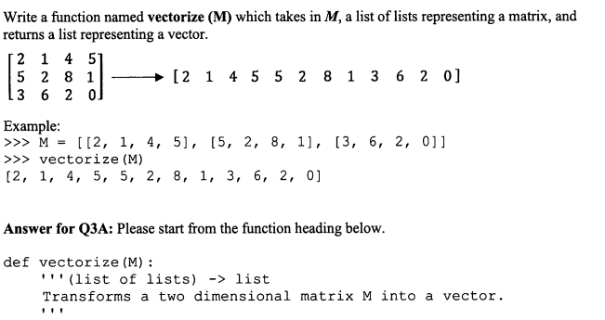
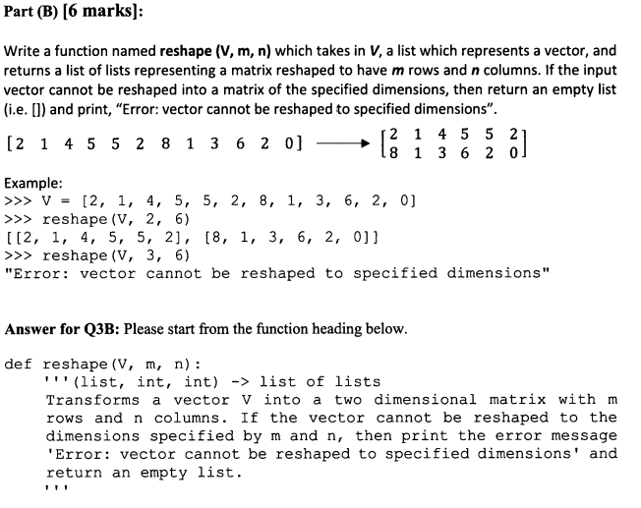
Question 4 (if time)

Slide 79
See Jupyter Notebook for the solution!

